Slide 1

A Deadly Habit: Smoking and Youth
Anjana Delhi Becky Ruth Fred Salzmann
Notes:
FRED

Slide 2
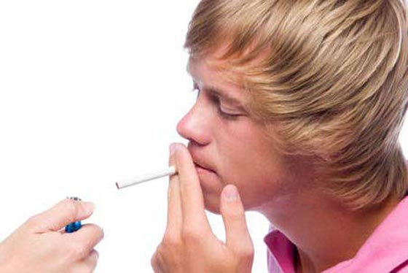
According to the CDC, each day in the US, approximately 1600 adolescents smoke their first cigarette.
If cigarette smoking continues at the current rate, 5.6 million of today’s Americans younger than 18 will die early from a smoking-related illness.
If smoking is a DEADLY CHOICE, why are youth making it?
Notes:
FRED

Slide 3
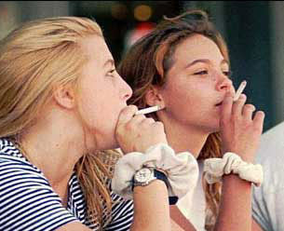
PURPOSE
To determine how to best address the problem of smoking among youth, we need to understand what factors make them more likely to develop this deadly habit.
WHAT race is more likely to start smoking?
WHAT age do teenagers start smoking?
WHAT type of marketing media is most effective?
Notes:
FRED

Slide 4


It’s personal
Notes:
FRED
Fred - This project is personal to us. Anjana and I are both parents.
Fred - I’m the dad of three girls. All are mixed race and the oldest is 11 - she just started middle school.
Anjana – I am the mom to two boys… add more demo info here
Anjana - Our group was excited to dig into this data - hoping it would give us some unbiased information to guide our decision making as parents.

Slide 5
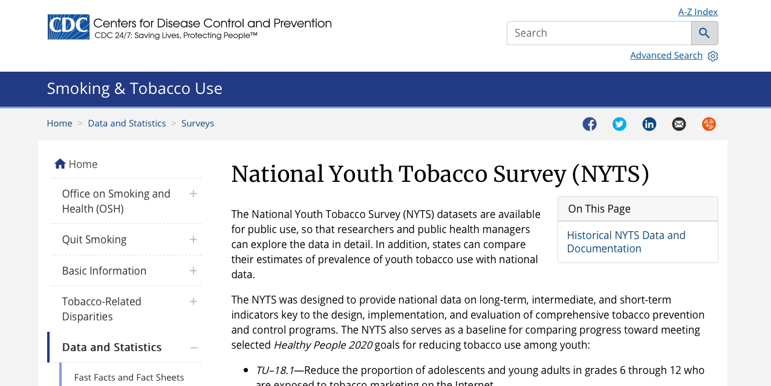
DATA EXPLORATION
Data extracted from 2019 CDC National Youth Tobacco Survey
19,018 respondents
104 questions
Large data set, however, it was not reported in a way that allowed extraction of relevant facts.
Notes:
ANJANA
MENTION THAT THE SURVEY WAS DONE BY TEENAGERS ONLY
STRENGTHS – 1. large sample size, 2. Nationally representative sample
LIMITATIONS - This study is a self reported survey so the answers may not be accurate due to social desirability bias or difficulty remembering past event timings.

Slide 6
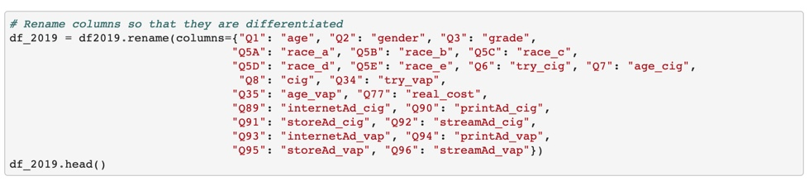
DATA CLEAN-UP
Renamed the response columns to allow extraction of relevant data.
Notes:
ANJANA - TALK ABOUT THE PROCESS WE USED TO SELECT THE QUESTIONS.

Slide 7
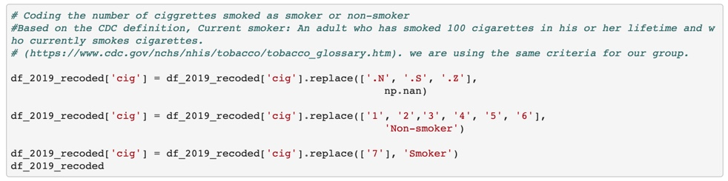
DATA CLEAN-UP
Modified classification of smoker by recoding data from # of cigarettes smoked to a yes or no variable.
Notes:
ANJANA – TALK ABOUT RECODING THE # OF CIGARETTES CDC SAYS 100 IS FULL TIME SMOKER

Slide 8
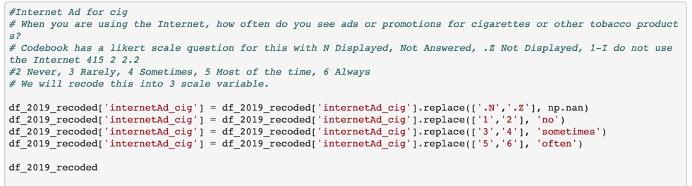
DATA CLEAN-UP
Recoded likert scale from seven to three variables.
Notes:
ANJANA - TALK ABOUT CHANGING FROM A LIKERT SCALE TO 3 VARIABLE SCALE

Slide 9
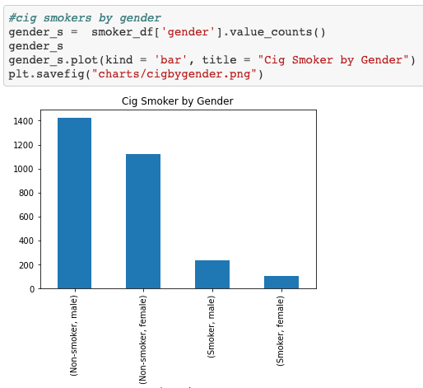
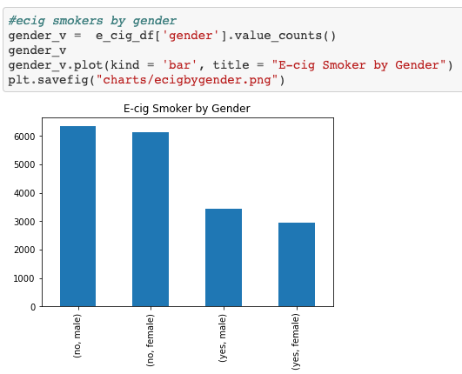
DATA ANALYSIS
What gender is more likely to smoke?
Notes:
BECKY – TALK ABOUT THE GENDER THAT SMOKES MORE

Slide 10
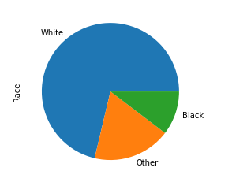
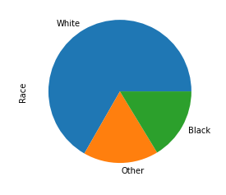
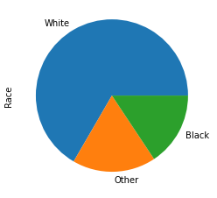
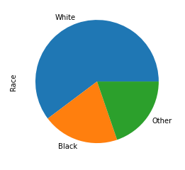
DATA ANALYSIS
Cigarette Smokers
Cigarette Non-Smokers
E-Cigarette Smokers
E-Cigarette Non- Smokers
WHO is more likely to start smoking?
Notes:
BECKY - WHO IS MORE LIKELY TO START SMOKING? … WHITE PEOPLE

Slide 11
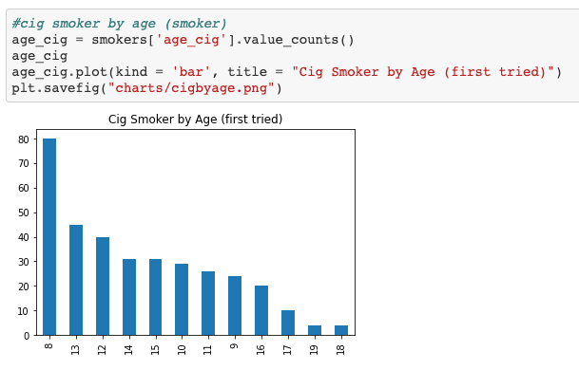
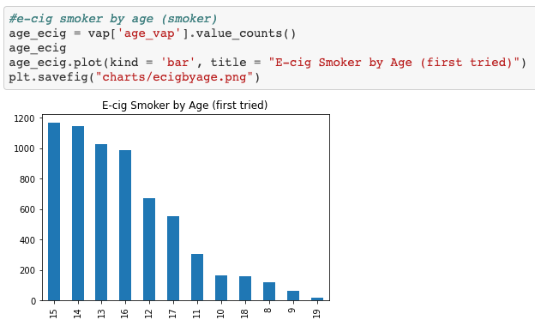
DATA ANALYSIS
At what age do youth start smoking?
Notes:
BECKY – AVERAGE AGE PEOPLE STARTED SMOKING COMPARED TO AVERAGE AGE SMOKING E-CIGS

Slide 12
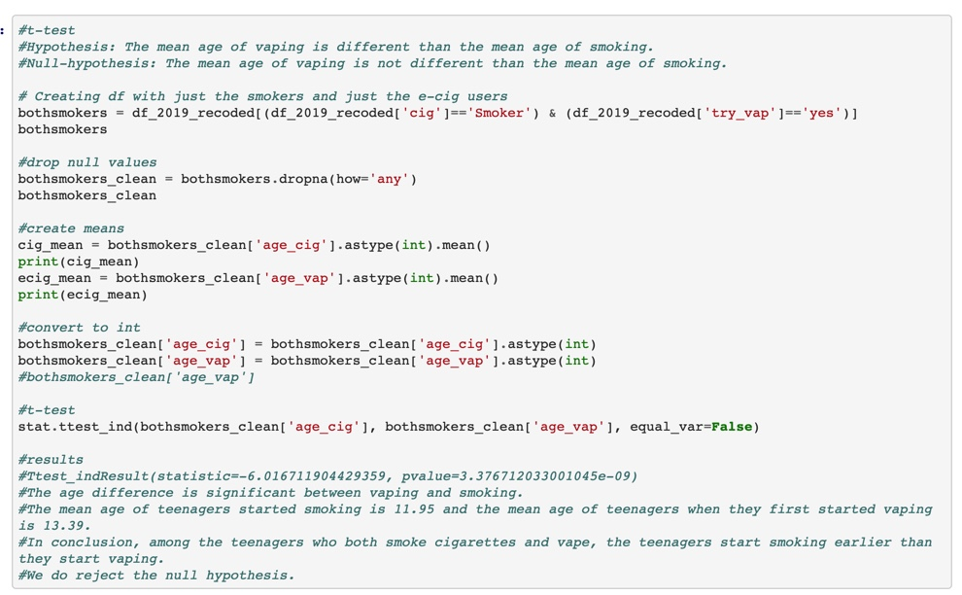
DATA ANALYSIS & DISCUSSION
T-test analysis revealed that youth start smoking cigarettes before they start vaping
WHY?
Notes:
FRED –
We looked at all the respondents that smoked and vaped. We wanted to know if smoking cigarettes led to vaping or vice versa.
After running the T-test we concluded that teenagers who ended up vaping started smoking cigarettes first and then vaped.
We were a little surprised by what the data said and decided to discuss it further.

Slide 13

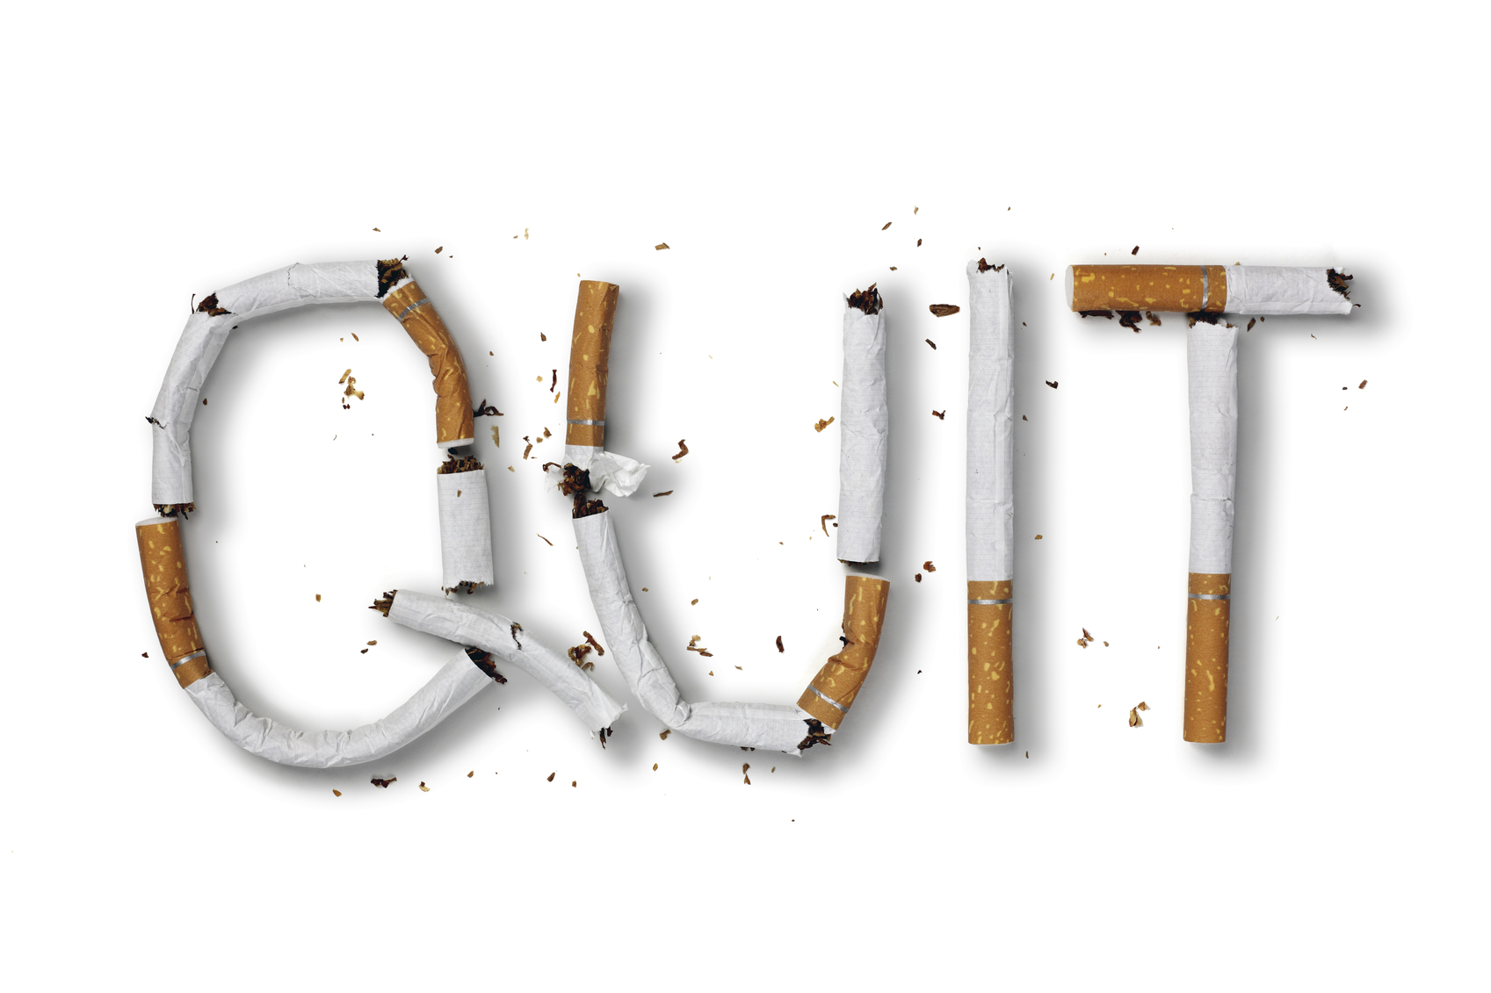

WHY are are youth starting to smoke cigarettes at an earlier age than vaping?
Notes:
FRED
Our Theories include
-Smoking cigarettes is cheaper. It takes less money to start the habit with a cigarette then it does to start vaping. Also people are more likely to give you a cheaper cigarette then let you use your more expensive vape.
-It could also be the side affects of smoking cigarettes. Many people don’t like the smell or the flavor of cigarettes. Vaping offers the same nicotine without the nasty affects.
I know they are young, but maybe some teenagers are using vaping to help overcome their addition to Nicotine.
This is something we would like to look into deeper to discover the real reason kids start on cigarettes.

Slide 14
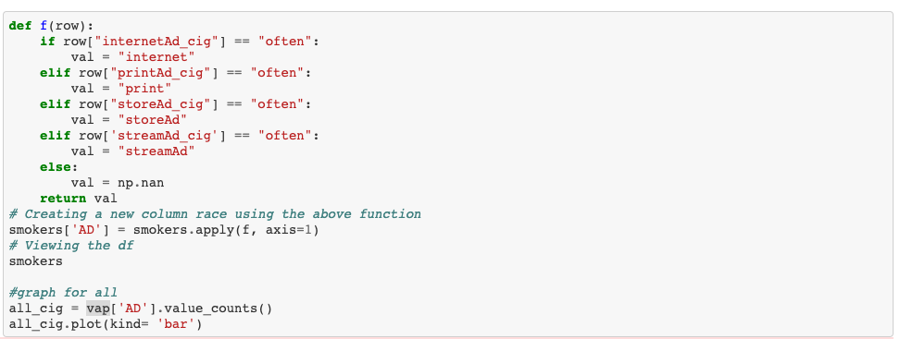
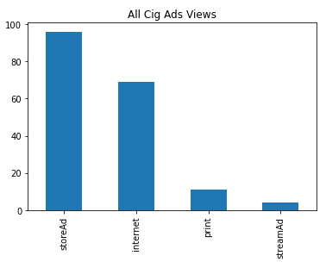
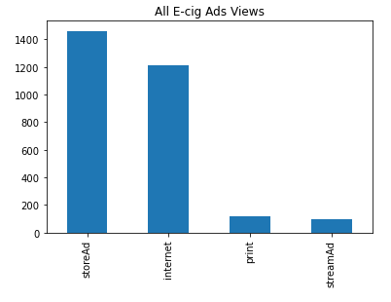
DATA ANALYSIS & DISCUSSION
WHAT type of nicotine marketing media is most effective?
WHY?
Notes:
FRED

Slide 15
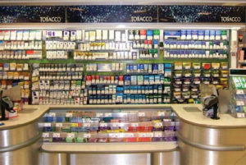

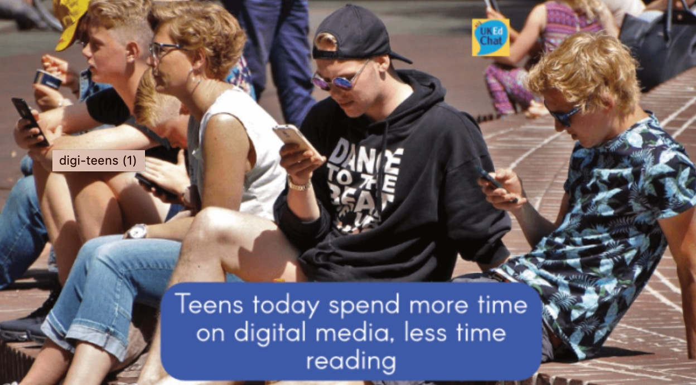
WHY is point of sale nicotine marketing media most effective?
Notes:
FRED
-Through the years - and most recently in 2009 with the Family Smoking Control and Prevention Act - the federal government has put severe restrictions on the the advertising of tobacco products.
-They are allowed to be advertised in some print media - but teens are less likely to read.
-So that leaves point of sale advertising – According to the American lung association tobacco and e-cigarette companies spend 96% of their marketing budgets on point of sale advertising.

Slide 16
It’s personal
Notes:
FRED
FRED - Good data analysis is always... personal.
FRED - This project has provided unbiased data to guide my decisions as a parent. I was shocked to find out that one of my daughters might try her first cigarette THIS year
FRED - but as a girl dad I am happy to find out boys are more likely to start smoking than girls. All my girls are non-white so that also makes it less likely they’ll start smoking.
ANJANA – My boys are also non-white, but their gender makes them more susceptible to smoking. I guess that means no more visits to the cigar lounge.
FRED - I’ll likely do my best to keep my daughters out of convenience stores - which means I may go crazy filling their gas tanks when they start driving.

Slide 17

Questions?
Notes:
Thank you for your time, Do you have any questions? Softballs only please!

